Slide 1


Lova Candles
SEO​
Growth Report​
22 Dec– 05 Mar​

Slide 2
Introduction
Google Analytics Overview​
Shopify Data
Google Search Impact
Site Map Submitted
Google Analytics Overview​​
Users By Country​
TOPIC HIGHLIGHTS​

Slide 3
INTRODUCTION
Project Duration
The Project started from the month of 22 December. And is currently ongoing.
Project Description
My work involved optimizing the website's content, improving its search engine rankings, and enhancing its online visibility. I focused on on-page and off-page SEO strategies, including keyword research, content optimization, backlink building, and technical SEO enhancements. The goal was to increase organic traffic, improve user experience, and drive online sales for the store's extensive range of products.

Slide 4
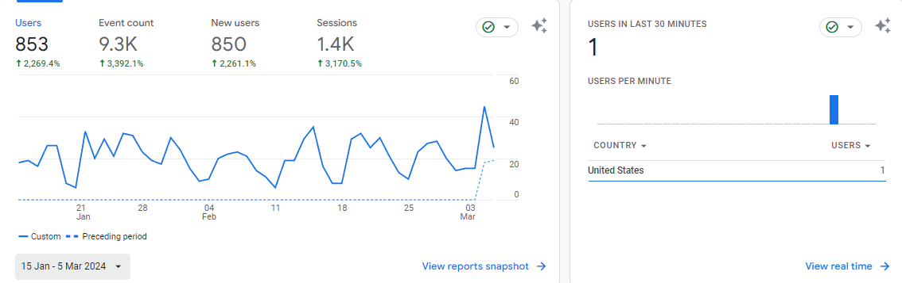
GOOGLE ANALYTICS OVERVIEW​
This Slide shows the increase in Users, Event Count, New Users and Sessions From 15 Jan- 5 March.

Slide 5
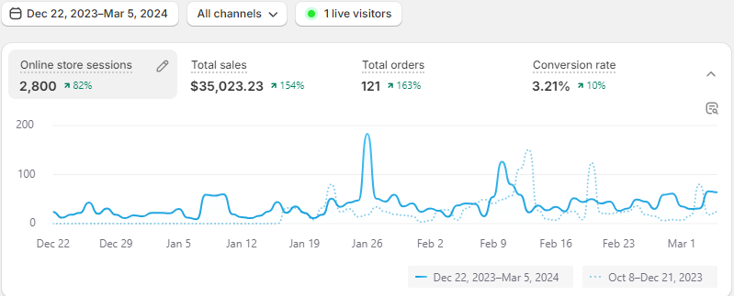
Shopify Data
This Slide Shows the growth percentage in Online store sessions, Total Sales, Total Orders and Conversion Rate.

Slide 6
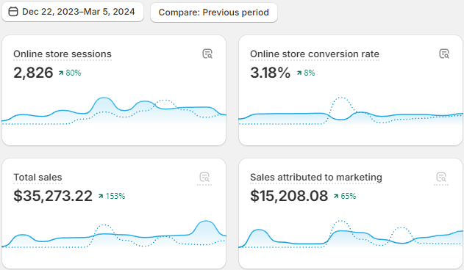
Shopify Data
This slide shows growth percentage in Online Store Sessions, Online Store Conversion Rate, Total Sales and Sales Attributed To Marketing.

Slide 7
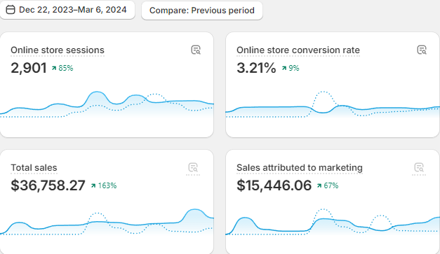
Shopify Sales Data

Slide 8
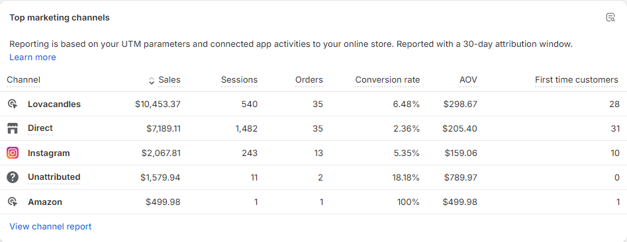
Shopify Sales Data

Slide 9
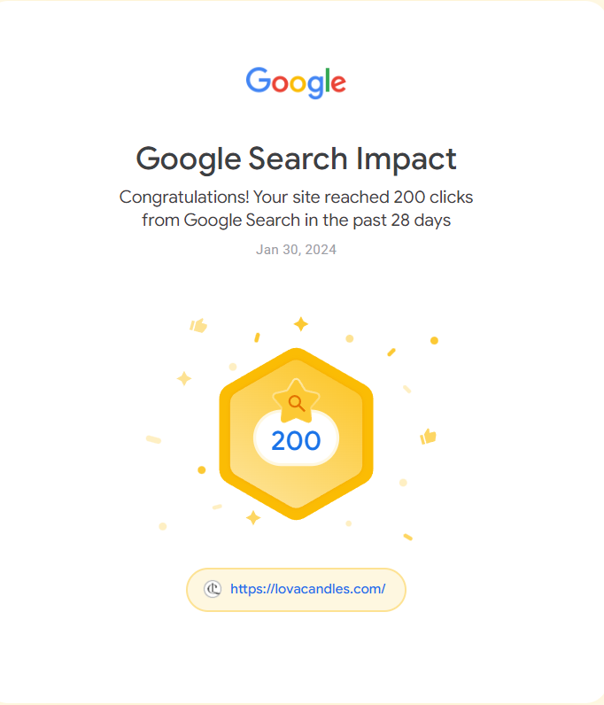
Google Search Impact
This Slide shows the Overall Growth in Our Website Lova Candles. Comparisons are drawn from Trusted Source like GSC(Google Search Console) ​

Slide 10
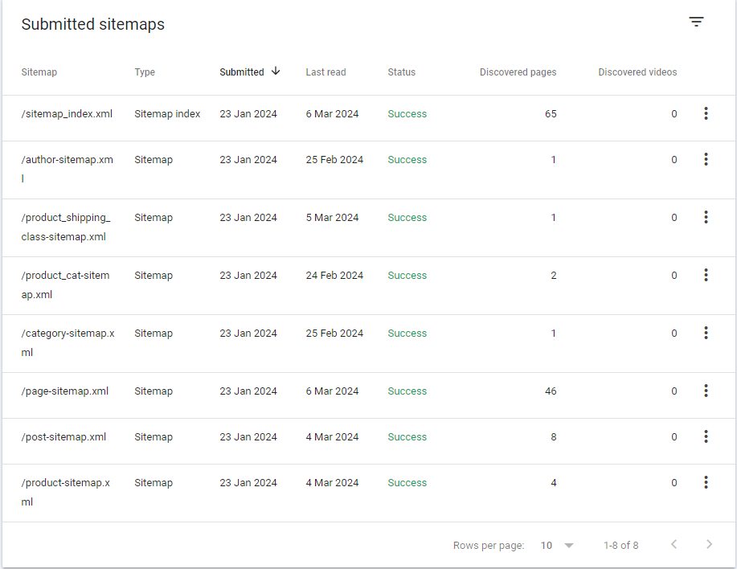
Site Map Submitted
This Slide Shows the submitted sitemaps ensuring different pages, products and collection that has been indexed.

Slide 11
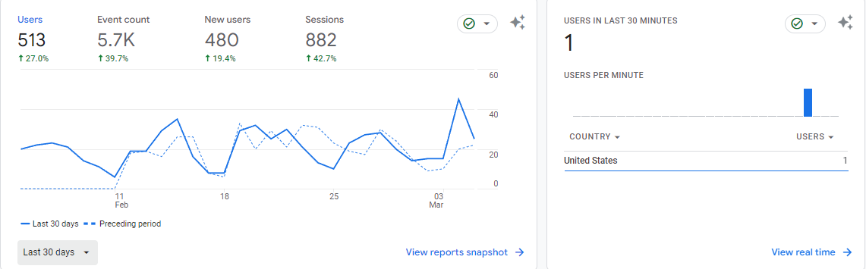
GOOGLE ANALYTICS: Overview​​
This slide shows the increase in the number of Users, Event Count, New Users and Sessions in the last 30 Days.

Slide 12
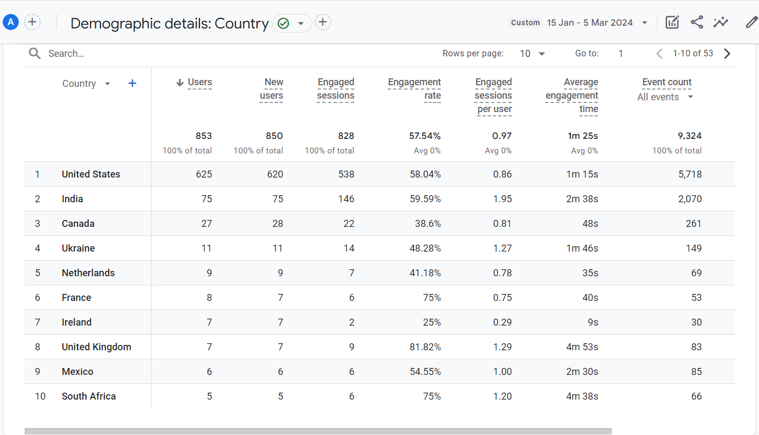
Users By Country​
This Slide shows the growth in the number of different users from Different Demographic Details From Different Parts Of the World.

Slide 13

Thank You
info@digirocket.io​
www.digirocket.io​

