Slide 1
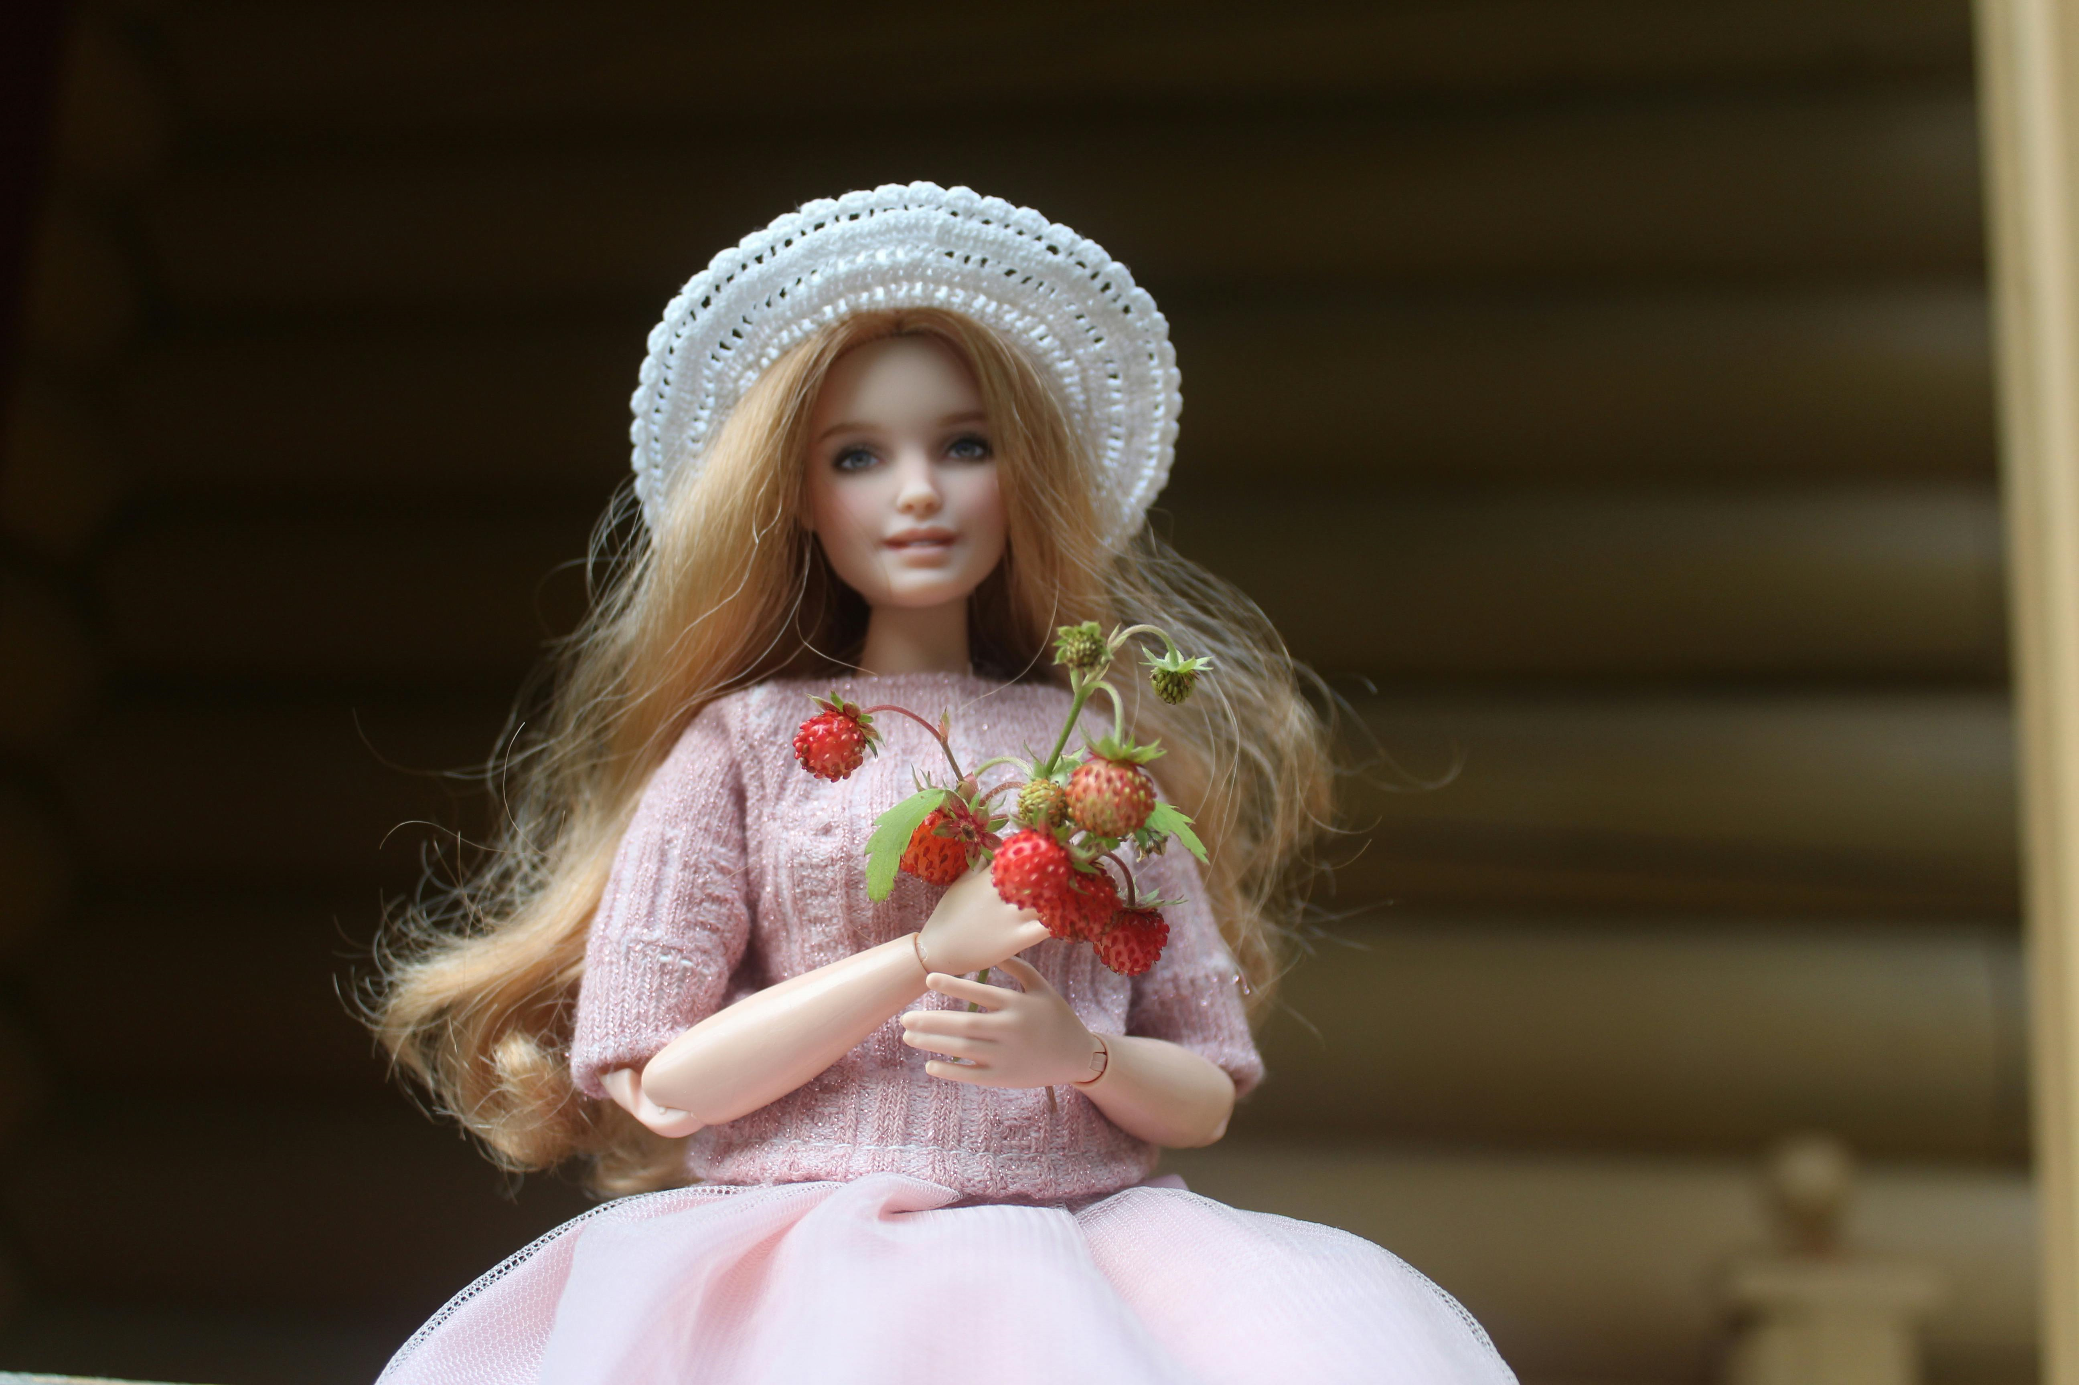


3 Months CASE
STUDY

Slide 2
OVERVIEW
Introduction
Initial Stage
Research and Analysis
Strategy and Planning
Results
Last Month Sale
Lessons Learned

Slide 3
INTRODUCTION
Client Background
The Doll Planet Hair is a specialty shop for customizing fashion dolls. Here you will find rerooting kits, nylon in straight, crimped, curly, s-curl and micro braids, Japanese saran, specialty glues, rerooting needles, apoxie sculpt, liner brushes, Gouache Acrylic Paints and other specialty supplies and tools for doll customization. FREE tutorials to help you learn to reroot and to help with advanced rerooting skills @ YouTube.com/TheDollPlanet. An amazing community of customizers on Facebook, "The Doll Planet Rerooters & Wig Makers", here you can post your work, ask for help, receive commission requests and talk all things dollies. The owners, Diana & Seth, are customizers too and have an awesome production and shipping team based out of Avondale, Arizona, USA.
Project Duration
The SEO project for DollPlanet started on May 2024, and still working on it.
Project Description
My work involved optimizing the website's content, improving its search engine rankings, and enhancing its online visibility. I focused on on-page and off-page SEO strategies, including keyword research, content optimization, backlink building, and technical SEO enhancements. The goal was to increase organic traffic, improve user experience, and drive online sales for the store's extensive range of products.

Slide 4
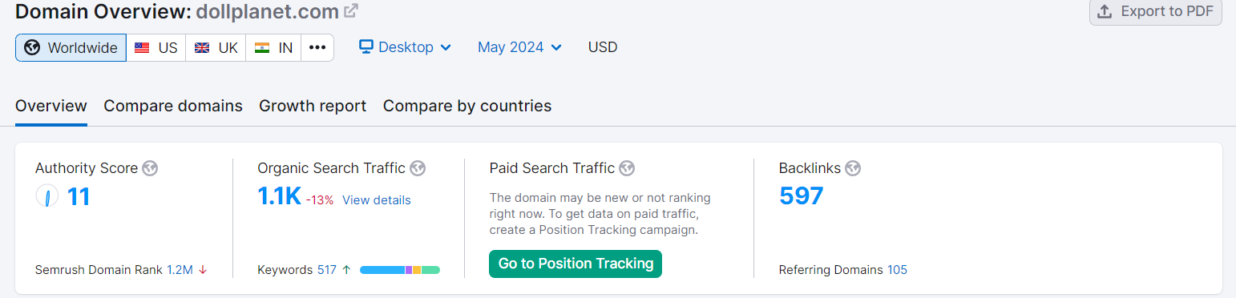
INITIAL STAGE

Slide 5
RESEARCH AND ANALYSIS
Keyword Research
Extensive keyword research was conducted to identify relevant keywords in the camera and electronics niche. This included keywords related to camera brands, product types, and location-specific keywords such as "Doll Hair."
Competitor Analysis
Analyzed the SEO strategies of key competitors in the camera and electronics retail industry. This involved identifying their top-performing keywords, backlink profiles, and content strategies.
On-Page SEO
Conducted on-page optimization by optimizing meta titles, meta descriptions, and headings with the identified keywords.
Ensured that product descriptions and category pages were well-structured with keyword-rich content.
Improved internal linking to enhance user navigation and distribute link equity effectively.
Local SEO
Optimized the website for local SEO, targeting local keywords such as "."

Slide 6
RESEARCH AND ANALYSIS
Technical SEO
Addressed technical issues, including improving website speed and mobile responsiveness.
Optimized site structure for easier navigation and indexing by search engines.
Fixed any broken links and ensured proper XML sitemap setup.
Backlink Building
Implemented a backlink-building strategy to acquire high-quality backlinks from authoritative websites in the same industry.
Focused on obtaining backlinks from local directories and relevant blogs.
Results and Ongoing Strategy
Regularly monitored the website's performance, tracking improvements in organic traffic, keyword rankings, and conversion rates.
Adjusted the SEO strategy as needed to adapt to changes in search engine algorithms and user behavior.

Slide 7
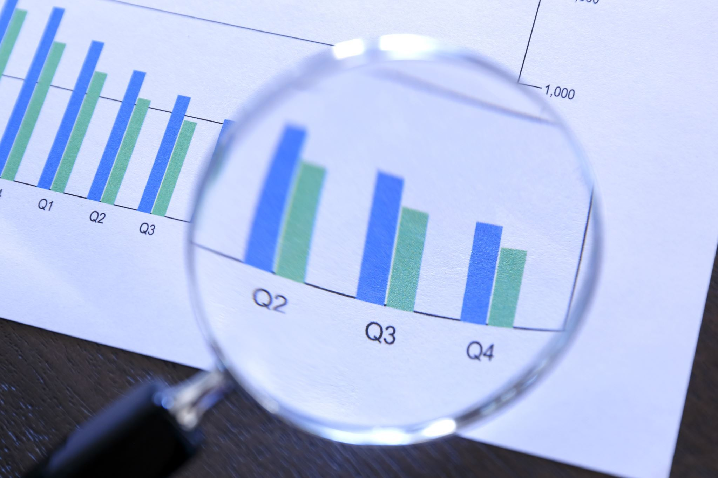
RESULTS
The results include data from Shopify analytics, Google analytics, SemRush and Google Search Console in the next slide.

Slide 8
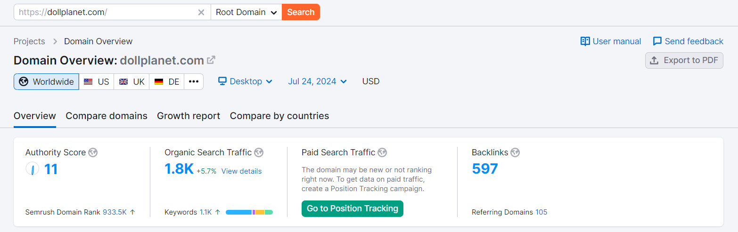
SEMrush Analytics
This slide demonstrates a significant increase in organic search traffic over the past 30 days. All metrics have shown overall growth.

Slide 9
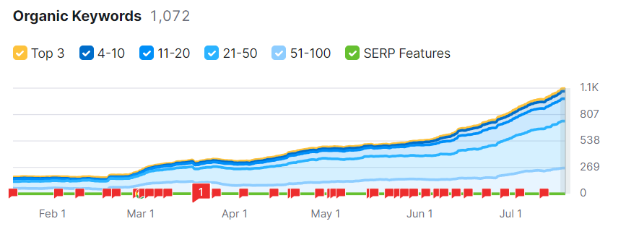
SEMrush Analytics
This slide shows the growth in terms of organic keyword in the last 2 months
When we started the work.

Slide 10
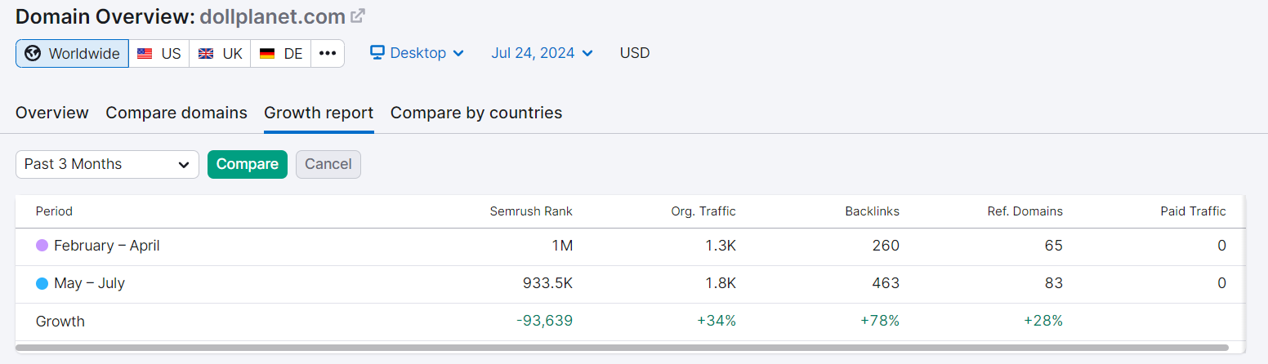
SEMrush Analytics​
This Slide shows the Growth Report Comparision drawn from previous 3 Months. When we worked on this client to the Current year Mid-May.
We Can clearly See the Growth percentage in the green numbers.

Slide 11
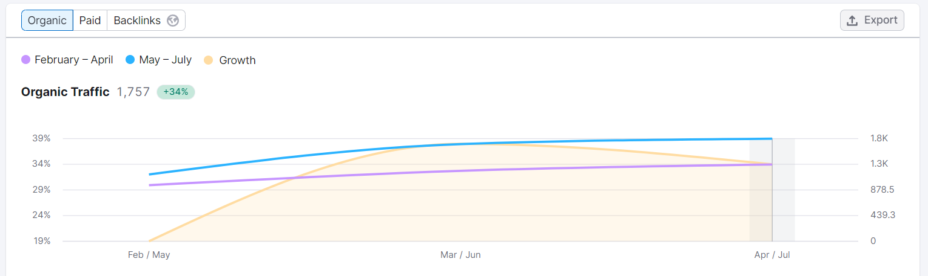
SEMrush Analytics​
This Slide show the Organic Traffic Growth in comparison to the last year. The Organic traffic has increased 34 % Compared to previous year When we started working on this project.

Slide 12
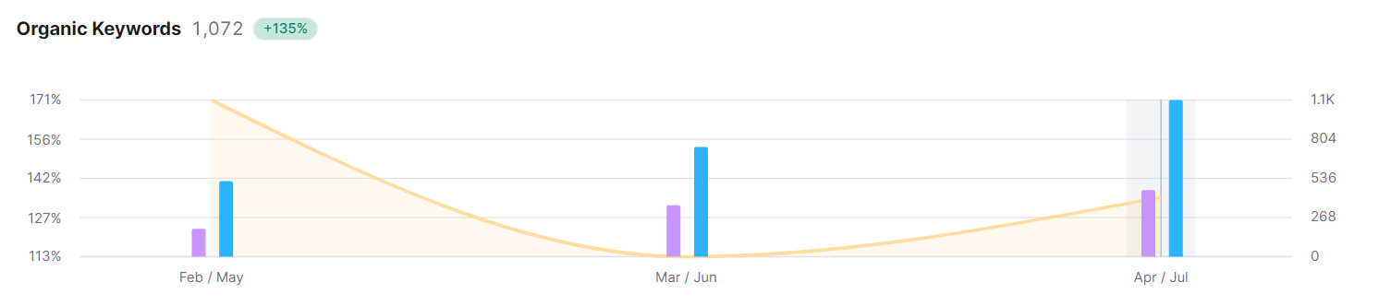
SEMrush Analytics​
This Slide Shows the Organic Keyword Growth of 135% compared to the previous year.

Slide 13
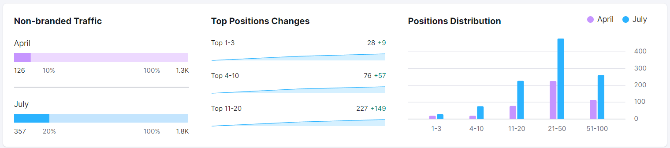
SEMrush Analytics
This Slide shows Non-branded Traffic, Top Position Changes and Position Distribution Compared to the previous year when we started working on this project.

Slide 14
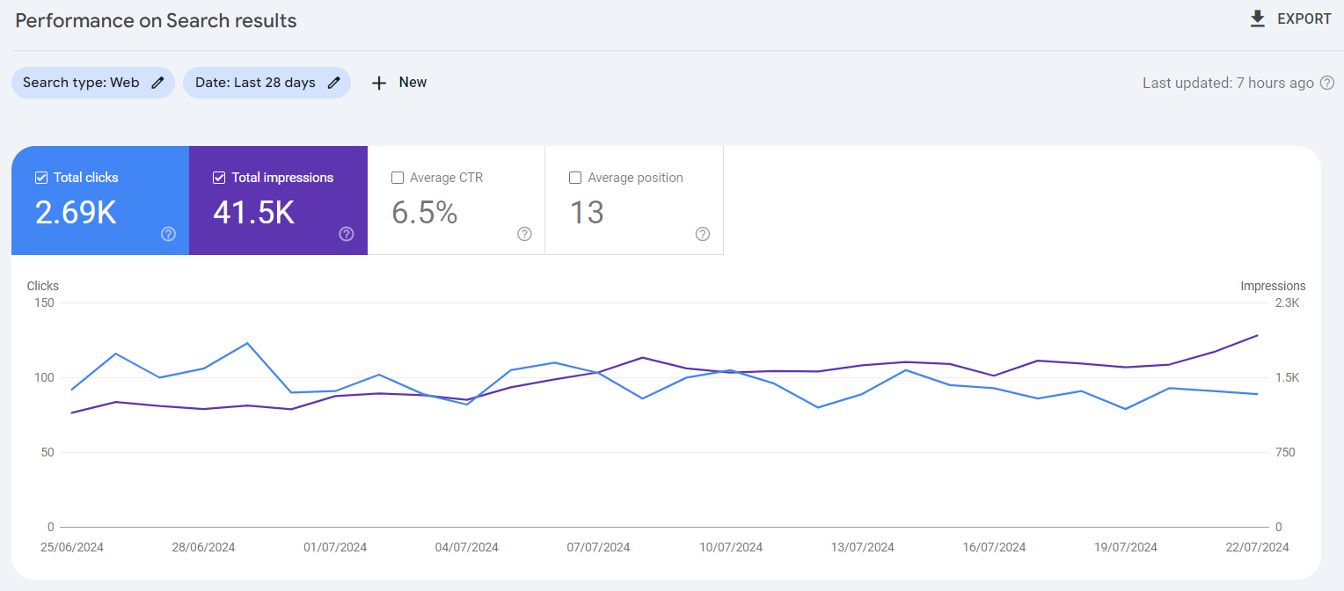
Performance on Search Results
This slide shows a comparison of data 29 June to 29 July from previous month to this month.

Slide 15
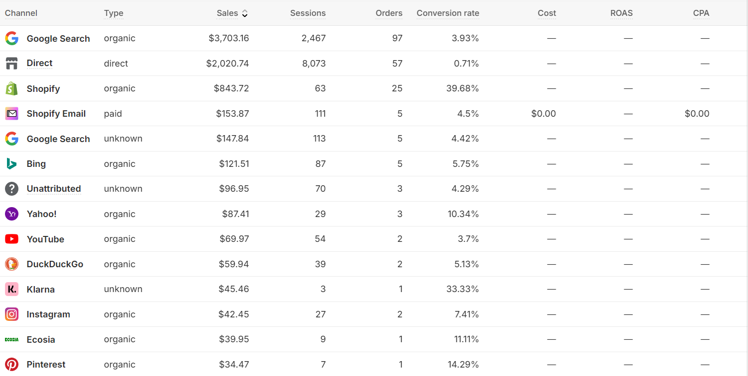
Shopify Analytics
This Slide shows the Growth We achieved in the previous 60 days. We can see an extraordinary growth from the organic results.

Slide 16
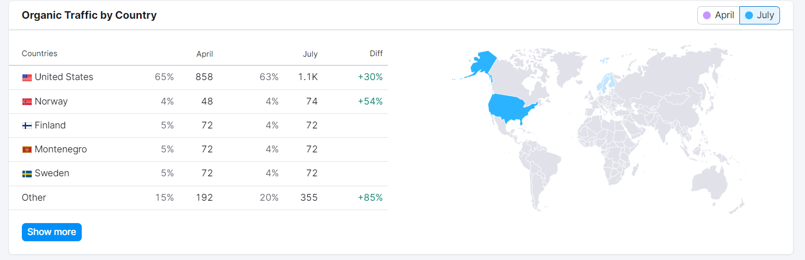
This Slide show the growth in Organic Traffic By Country with specified regions.

Slide 17
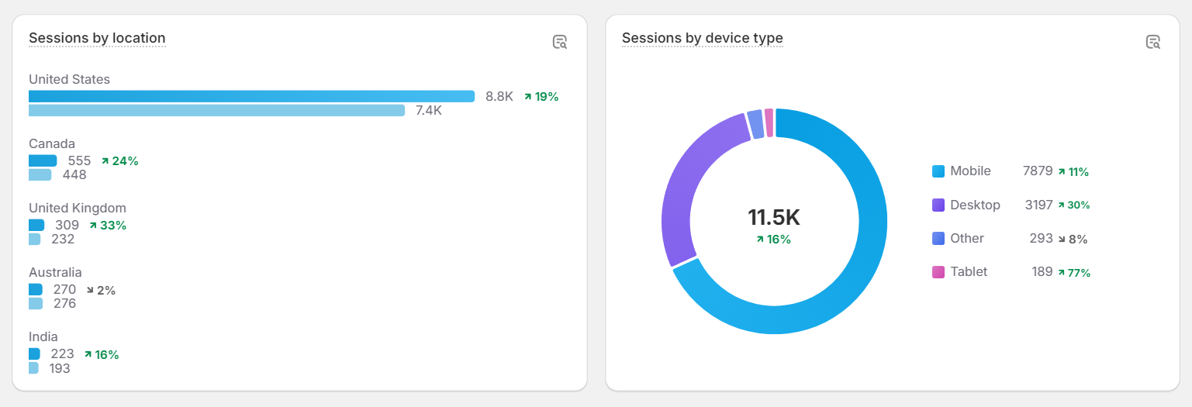
Sessions By Location
This Slide shows the growth in sessions by different locations compared to the
last 3 months.

Slide 18
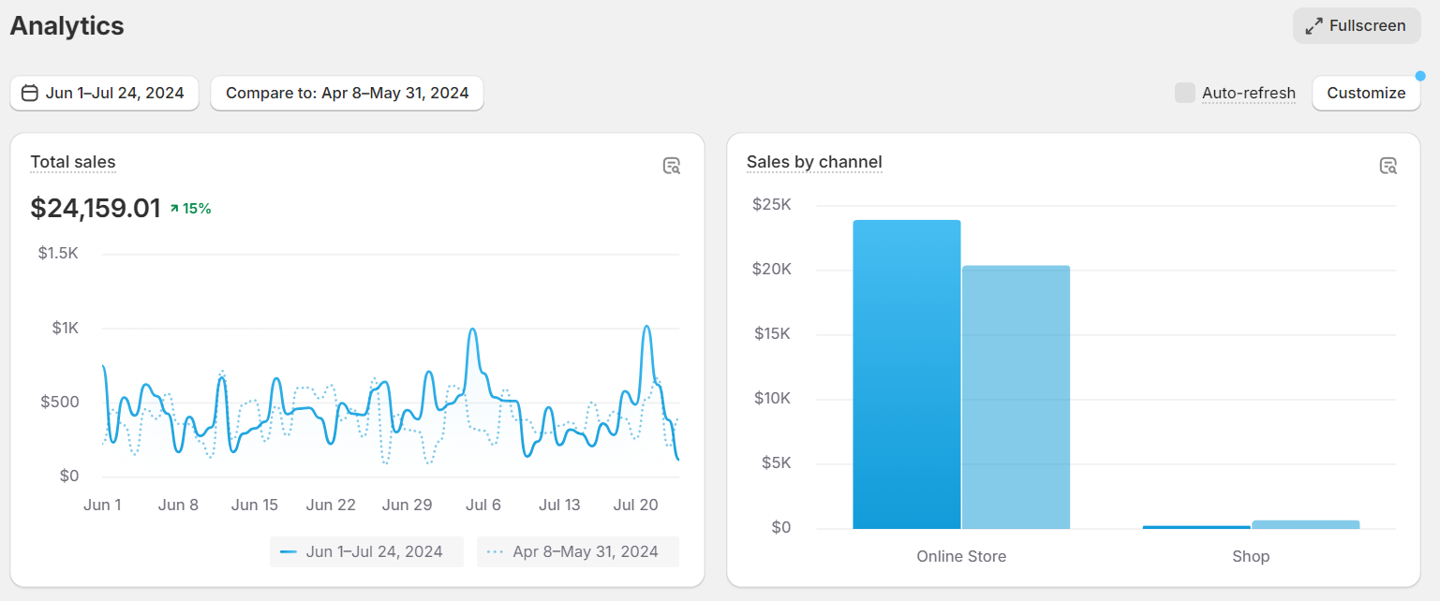
Sales Analytics
This Slide shows the Analytics Overview. We can See the growth in Online store compared to the last month.

Slide 19
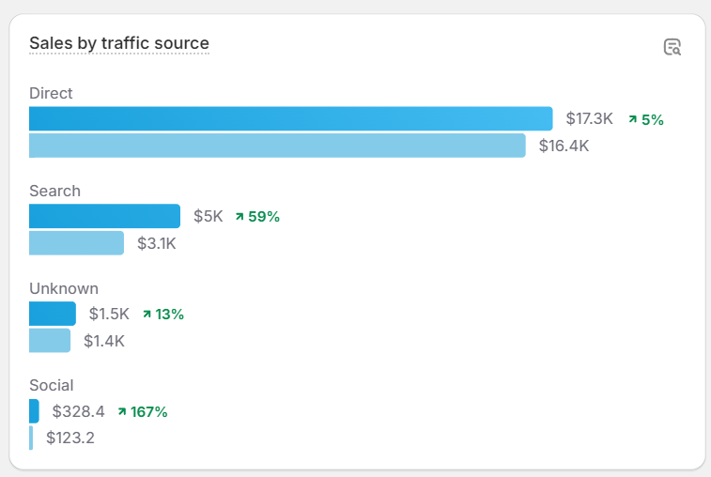
Sales By Traffic Source
This Slide show the growth for different Channels. We can See Organic Search and Direct channel have the highest conversion.

Slide 20
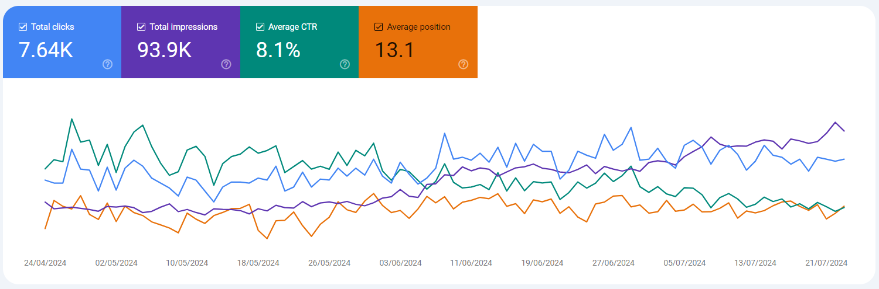
Search Console Analytics
This Slide show the growth in terms of Total Clicks, Total Impressions, Average CTR and Average Position.

Slide 21
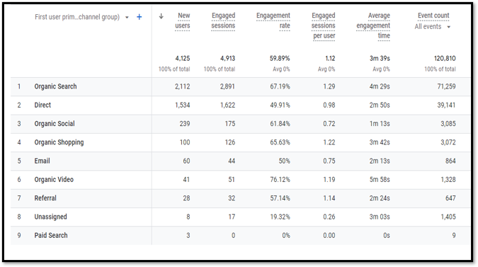
Sales By Traffic Source
This Slide show the growth for different Channels. We can See Organic Search and Direct channel have the highest conversion.

Slide 22
Lessons Learned
More than anything, with this case study, you can see the importance of why “content is king”.
Why?
Because without getting the content strategy right in the first place, the technical changes and outreach activities that you implement won’t be half as effective.
I should also note that so far, we’ve focused on just one of the core services that the client specializes in. In the future, the plan is to adopt a similar approach for the other services that the client offers to its customers.
By applying a similar approach, you will be able to rank for twice as many keywords!
If you need help boosting your search presence just like this, don’t hesitate to reach out to my team over at The Digirocket Technologies

