Slide 1

SEO​
Growth Report​
Oct'23 – Mar'24
Presented by: DigiRocket Technologies

Slide 2
AGENDA
  Introduction
  Organic Metrics
  Research & Analysis
  Challenges & Solutions
  Google Search Console
  Blog Engagement
  Research, Analysis & Suggestions

Slide 3
INTRODUCTION
Client: Camelina Gold
Website: https://camelinagold.com/
Start Date: OCT 2023
End Date: Ongoing
Camelina Gold Company is Greenwalt family has farmed in Washington state for more than 110 years. this SEO project is designed to improve the online visibility, organic traffic, and overall web presence of the company. The primary objective is to enhance the website's ranking on search engine result pages (SERPs) to attract a broader audience and increase online sales.​

Slide 4
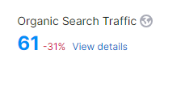
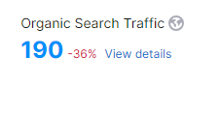
ORGANIC METRICS
Oct 2023
March 2024

Slide 5
RESEARCH & ANALYSIS
To perform effective SEO research and analysis for the project related to camelinagold.com, the following steps and considerations were taken into account :
Website Audit:​
​
We conducted a thorough audit of the Camelina Gold website to assess its technical health, including factors like site speed, mobile-friendliness, and crawlability. This audit helped us identify areas that require optimization.
Keyword Research:​
​
Extensive keyword research was performed to identify the most relevant and high-impact keywords related to Camelina Seed, Camelina Pet Oil, and Camelina Equine Oil. This forms the basis for our content and optimization strategies.​

Slide 6
RESEARCH & ANALYSIS
Content Evaluation:
We evaluated the existing website content to determine its quality, relevance, and alignment with the identified keywords. This assessment will guide content optimization efforts.
Technical SEO:​
​
  Addressed technical issues, including improving website speed and mobile responsiveness.​​
  Optimized site structure for easier navigation and indexing by search engines.​​
  Fixed any broken links and ensured proper sitemap setup.​
Backlink Building​:​
​
  Implemented a backlink-building strategy to acquire high-quality backlinks from authoritative websites in the same industry.​​
  Focused on obtaining backlinks from local directories and relevant blogs.​

Slide 7
CHALLENGES AND SOLUTIONS
Low Search Engine Rankings:​
Challenges: The website was underperforming in search engine rankings, leading to reduced online visibility.​
Objectives: Implemented comprehensive on-page and technical SEO strategies to optimize meta tags, schema markup, and improve overall site performance.
High Competition
Challenge: Intense competition in the e-commerce sector made it challenging to stand out in search results.
Solution: Focused on long-tail keywords and niche-specific content to target a more specific audience and gain an edge.

Slide 8
RESULTS
The results include data from Shopify analytics, Shopify analytics, SEMrush, Google Analytics 4, and Google Search Console in the next slide.

Slide 9
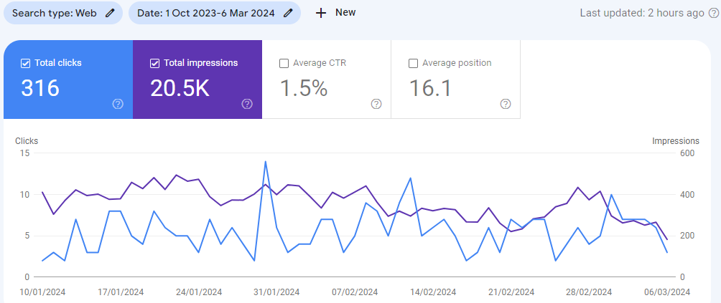
GOOGLE SEARCH CONSOLE: Clicks & Impressions
The above graph represents data for total clicks, total impressions, average CTR, and average position of the website, form of Oct 2022 to Mar 2024. ​

Slide 10
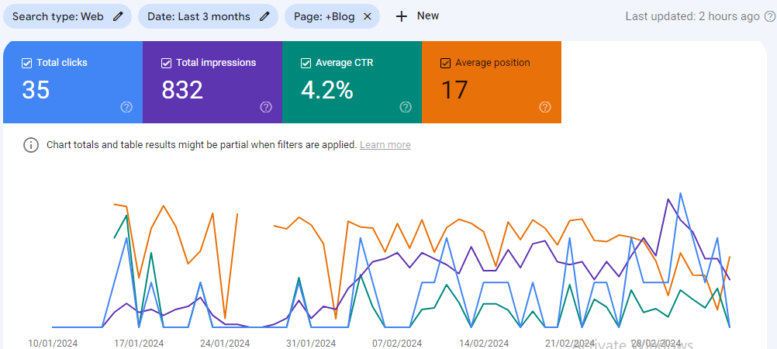
BLOGS PERFORMANCE ON SERP
Data taken from Google Search Console.

Slide 11
Blog Performance on SERP
All keywords on SERP for blog pages, their impression and Position.
S.No | Top queries | Impressions | Position
1 | what cooking oil is best | 27 | 1.00
2 | is camelina oil safe for dogs | 23 | 41.70
3 | camelina oil for dogs | 15 | 49.67
4 | healthy cooking oils | 13 | 99.00
5 | camelina oil for horses | 11 | 36.09
6 | healthy cooking oil | 8 | 52.88
7 | is camelina oil good for dogs | 7 | 43.71
8 | is gold bar of soap a harsh soap | 5 | 10.40
9 | best cooking oil | 4 | 7.25
10 | what is the best cooking oil | 3 | 1.00
11 | camelina seeds benefits | 3 | 43.33
12 | good cooking oils | 3 | 92.00
13 | gold soap benefits for face | 2 | 10.00
14 | camelina oil for dogs benefits | 2 | 11.50
15 | camelina oil horse | 2 | 43.00
16 | gold soap benefits | 2 | 50.50
17 | camelina oil for cats | 2 | 51.50
18 | healthier cooking oil | 2 | 73.50
19 | comparing cooking oils | 2 | 84.00
20 | which oil is healthier for cooking | 2 | 89.50

Slide 12
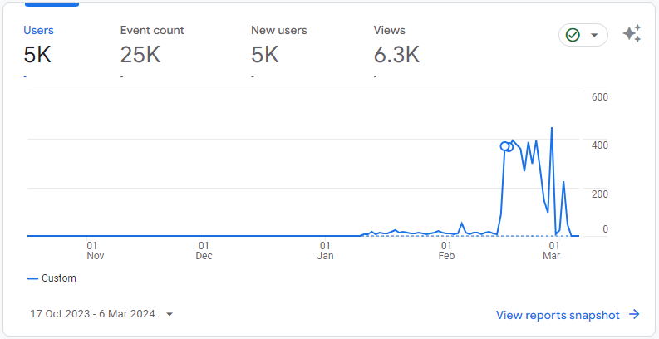
GOOGLE ANALYTICS: Overview
This graph represents an overview report for Oct 2023 to Mar 2024 which shows continuous growth.

Slide 13
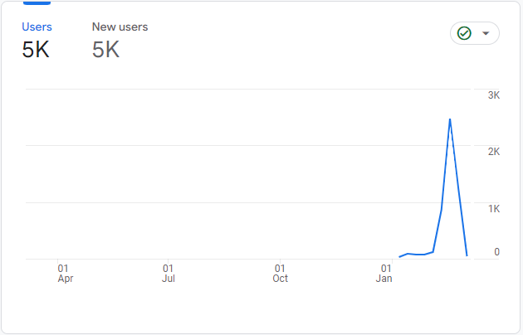
Acquisition overview: Comparison
October 2023 to March 2024

Slide 14
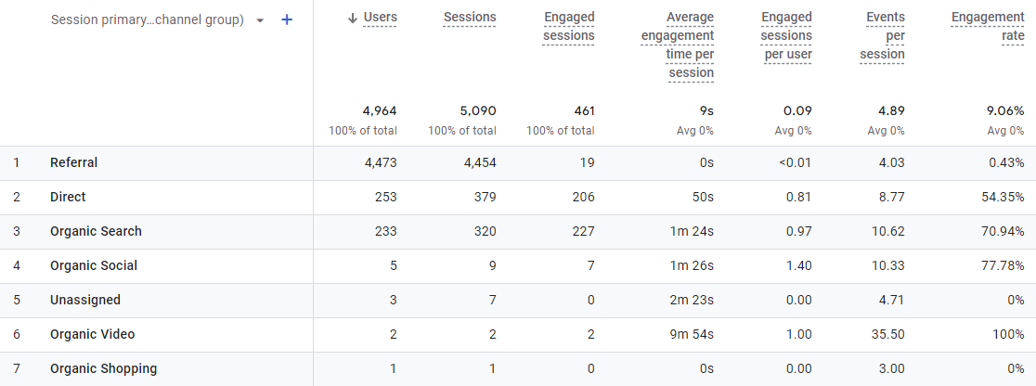
GOOGLE ANALYTICS: Traffic Acquisition
Detailed representation of traffic acquisition from various sources. The above graph shows us traffic acquisition from Oct 2023 to Mar 2023.

Slide 15
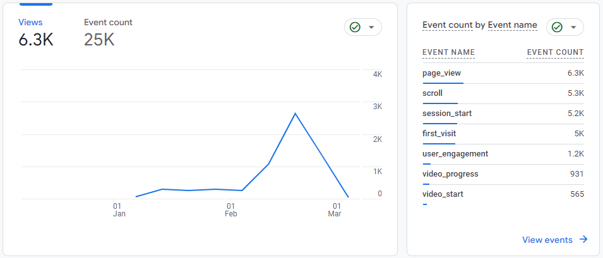
GOOGLE ANALYTICS: Engagement Overview
The above graph shows us data for engagement overview during the duration of Oct 2023 to Mar 2024.
Event Count: An event is a user's specific action on your site, such as clicking a button, playing a video, or Scroll.
Views: Views count the number of total pages viewed by all users during all sessions.

Slide 16
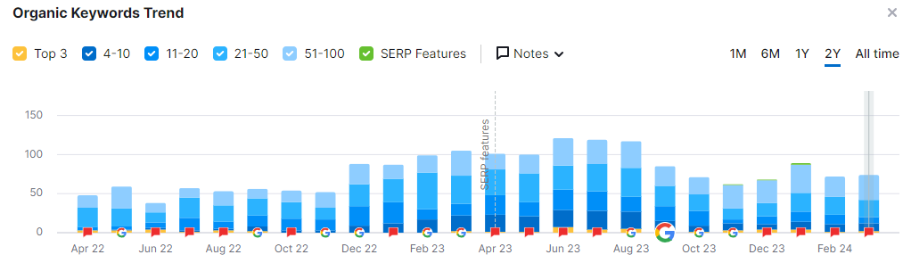
ORGANIC KEYWORDS GRAPH
This Slide shows the growth of the website in the past months. The Data is backed by the most trusted tool SEMrush. ​

Slide 17
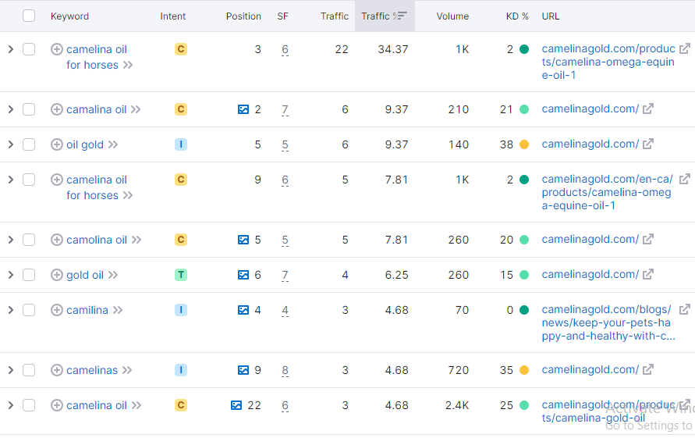
This Slide shows the keyword's rank in the past, months. The Data is backed by the most
trusted tool SEMrush. ​

Slide 18
RESEARCH, ANALYSIS & SUGGESTIONS
Backlink Building​ & Website Blogs:​
  Implement a backlink-building strategy to acquire high-quality backlinks from authoritative websites in the same industry by increasing the count of backlinks.​​
  Focus on publishing more website blogs to generate informative content and attract more users.​
Google Ads:​
  Start Ad campaign to reach & target audience on various other platforms like Shopping Tab other Google Apps.

Slide 19
THANK YOU

