Slide 1



SEO
Growth Report
Nov'22 – Feb'24
Presented by: DigiRocket Technologies

Slide 2
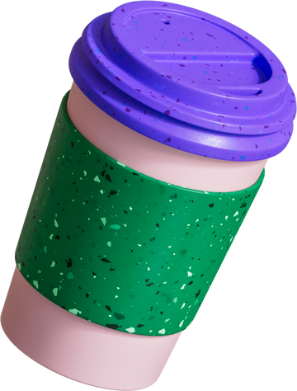


Agenda
  Introduction​
  Initial Stage​
  Research & Analysis​
  Problems & Solutions
  Backlinks report
  Blog Engagement​
  Results​

Slide 3


INTRODUCTION
Client: Alamo City Popcorn
Industry: Popcorn Store
Website: https://alamocitypopcorn.com/​
Start Date: Nov 2022
End Date: Ongoing
The Alamo City Popcorn Company is a family-owned gourmet popcorn business located in San Antonio, Texas. This SEO project is designed to improve the online visibility, organic traffic, and overall web presence of the company. The primary objective is to enhance the website's ranking on search engine result pages (SERPs) to attract a broader audience and increase online sales.​

Slide 4

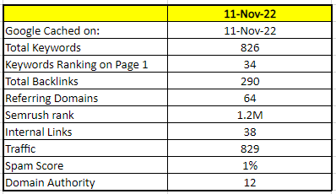
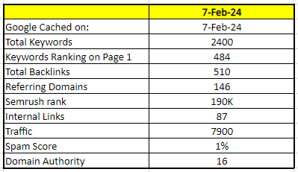

INITIAL STAGE​
The Alamo City Popcorn Company is a family-owned gourmet popcorn business located in San Antonio, Texas. This SEO project is designed to improve the online visibility, organic traffic, and overall web presence of the company. The primary objective is to enhance the website's ranking on search engine result pages (SERPs) to attract a broader audience and increase online sales.​
Initial Stage
Now

Slide 5
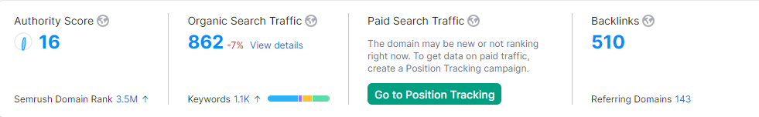
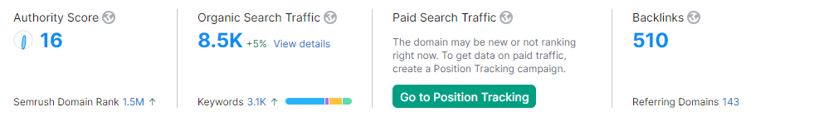
Organic Metrics
NOV 2022
FEB 2024
Note: The Authority Score and Backlinks are showing the same data in both slides because SEMrush doesn’t change these two when we check past data for different time periods.

Slide 6
RESEARCH & ANALYSIS​
To perform effective SEO research and analysis for the project related to alamocitypopcorn.com, the following steps and considerations were taken into account:​
Keyword Research:
Extensive keyword research was performed to identify the most relevant and high-impact keywords related to gourmet popcorn, flavored popcorn, and gift packs. This forms the basis for our content and optimization strategies.​
Website Audit:
We conducted a thorough audit of the Alamo City Popcorn website to assess its technical health, including factors like site speed, mobile-friendliness, and crawlability. This audit helped us identify areas that require optimization.
Local SEO:
Optimized the website for local SEO, targeting local keywords such as “Popcorn in San Antonio"​

Slide 7
RESEARCH &
ANALYSIS​
Technical SEO:
  Addressed technical issues, including improving website speed and mobile responsiveness.​
  Optimized site structure for easier navigation and indexing by search engines.​
  Fixed any broken links and ensured proper XML sitemap setup.​
Content Evaluation:
We evaluated the existing website content to determine its quality, relevance, and alignment with the identified keywords. This assessment will guide content optimization efforts.​​
Backlink Building​:
  Implemented a backlink-building strategy to acquire high-quality backlinks from authoritative websites in the same industry.​
  Focused on obtaining backlinks from local directories and relevant blogs.​
Competitive Analysis:
We analyzed the online competition within the gourmet popcorn industry, examining the strategies and tactics employed by key competitors.​

Slide 8
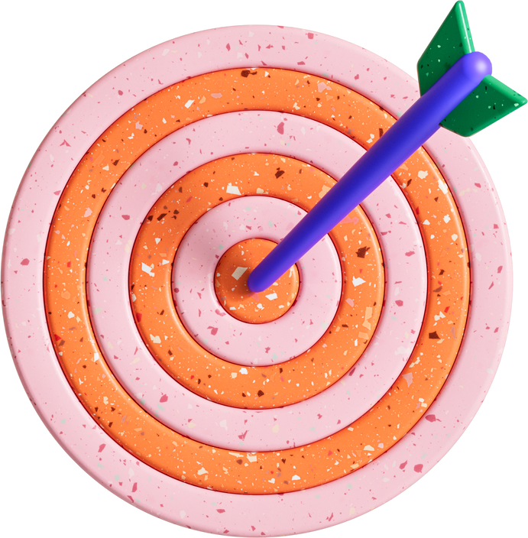
Challenges
and Solutions
Low Search Engine Rankings:​
Challenges: The website was underperforming in search engine rankings, leading to reduced online visibility.​
Objectives: Implemented comprehensive on-page and technical SEO strategies to optimize meta tags, schema markup, and improve overall site performance.
High Competition
Challenge: Intense competition in the e-commerce sector made it challenging to stand out in search results.
Solution: Focused on long-tail keywords and niche-specific content to target a more specific audience and gain an edge.

Slide 9

RESULTS​
The results include data from Shopify analytics, Shopify analytics, SEMrush, Google Analytics 4 and Google Search Console in the next slide.​

Slide 10
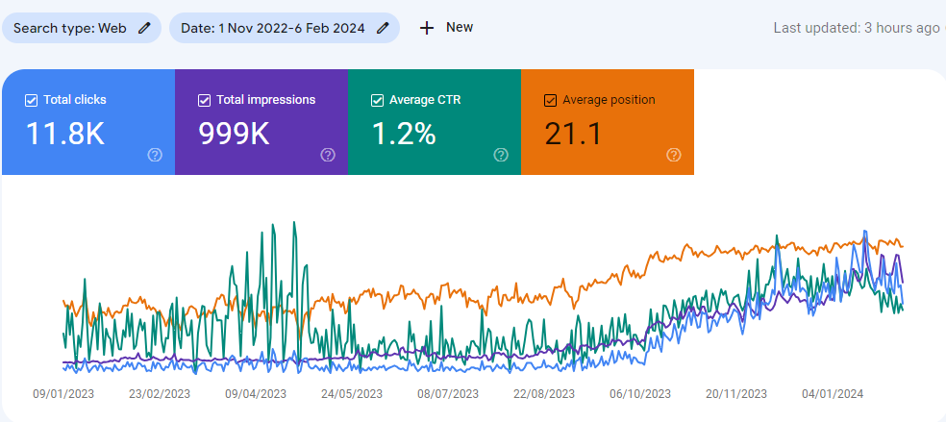
GOOGLE SEARCH CONSOLE: Clicks & Impressions​
The above graph represents data for total clicks, total impressions, average CTR and average position of the website, for the duration of Nov 2022 to Feb 2024. ​

Slide 11
BLOGS POSTED
S No | Blog Title | Blog URL
1 | Perfect Popping: 7 Tips for Choosing the Right Popcorn Tin! | https://alamocitypopcorn.com/blogs/blogs/perfect-popping-7-tips-for-choosing-the-right-popcorn-tin
2 | How can Popcorn Cones make your Party an addition to fun and celebration? | https://alamocitypopcorn.com/blogs/blogs/how-can-popcorn-cones-make-your-party-an-addition-to-fun-and-celebration
3 | Popcorn Tins Make Thoughtful Presents For Those You Care About. Let's find out! | https://alamocitypopcorn.com/blogs/blogs/popcorn-tins-make-thoughtful-presents-for-those-you-care-about-lets-find-out
4 | Why Are Caramel and Cinnamon Popcorn Becoming So Popular These Days? | https://alamocitypopcorn.com/blogs/blogs/why-are-caramel-and-cinnamon-popcorn-becoming-so-popular-these-days
5 | An Unforgettable Gift of Popcorn Bags for Someone Special! | https://alamocitypopcorn.com/blogs/blogs/an-unforgettable-gift-of-popcorn-bags-for-someone-special
6 | Uncover The Sweetest Candy Gift Packs For Every Occasion! | https://alamocitypopcorn.com/blogs/blogs/uncover-the-sweetest-candy-gift-packs-for-every-occasion
7 | Unlocking the Snacking Game: Top Five Flavors to Try with Premium Popcorn Kernels! | https://alamocitypopcorn.com/blogs/blogs/unlocking-the-snacking-game-top-five-flavors-to-try-with-premium-popcorn-kernels
8 | Get Your Gourmet Popcorn Cravings Satisfied with Alamo City Popcorn Company! | https://alamocitypopcorn.com/blogs/blogs/get-your-gourmet-popcorn-cravings-satisfied-with-alamo-city-popcorn-company
9 | Make Your Party Pop with Alamo City Popcorn's Popcorn Party Packs! | https://alamocitypopcorn.com/blogs/blogs/popcorn-party-packs-for-special-nights
10 | Pop into Flavor Town: Discover the Best Savory Popcorn Seasonings! | https://alamocitypopcorn.com/blogs/blogs/pop-into-flavor-town-discover-the-best-savory-popcorn-seasonings
11 | Sweet Bliss: A Fun, Unique and Delicious Candy Treat! | https://alamocitypopcorn.com/blogs/blogs/sweet-bliss-a-fun-unique-and-delicious-candy-treat

Slide 12
BLOGS POSTED
S No | Blog Title | Blog URL
12 | Indulge in Popcorn Paradise with popcorn gift baskets! | https://alamocitypopcorn.com/blogs/blogs/indulge-in-popcorn-paradise-with-popcorn-gift-baskets
13 | Pickle Popcorn: The Perfect Blend of Salty and Sour! | https://alamocitypopcorn.com/blogs/blogs/pickle-popcorn-the-perfect-blend-of-salty-and-sour
14 | Unveiling unique candy gifts and popcorn treasures! - Alamo City | https://alamocitypopcorn.com/blogs/blogs/unveiling-unique-candy-gifts-and-popcorn-treasures-alamo-city
15 | 8 Best Popcorn Flavors to Add to the Menu for Special Occasion! | https://alamocitypopcorn.com/blogs/blogs/8-best-popcorn-flavors-to-add-to-the-menu-for-special-occasion
16 | Cotton Candy Treats: An Exploration of Sweet Delights! | https://alamocitypopcorn.com/blogs/blogs/cotton-candy-treats-an-exploration-of-sweet-delights
17 | How to Enjoy Popcorn as Cereal and Elevate Your Morning Routine? | https://alamocitypopcorn.com/blogs/blogs/how-to-enjoy-popcorn-as-cereal-and-elevate-your-morning-routine
18 | Chicago mix popcorn: Must-Try Savory-Sweet Popcorn | https://alamocitypopcorn.com/blogs/blogs/chicago-mix-popcorn-must-try-savory-sweet-popcorn
19 | Popping the Lid on Popcorn: Fun Facts about Popcorn! | https://alamocitypopcorn.com/blogs/blogs/fun-facts-about-popcorn
20 | Is Popcorn Keto Friendly Snack? Nutritional Facts to Work it into a Low-Carb Diet | https://alamocitypopcorn.com/blogs/blogs/is-popcorn-keto-friendly-snack
21 | The history of popcorn: How one grain become a popular snack | https://alamocitypopcorn.com/blogs/blogs/the-history-of-popcorn-how-one-grain-become-a-popular-snack

Slide 13
BLOGS POSTED
S No | Blog Title | Blog URL
22 | Does Popcorn Expire? Here’s Everything You Need to Know | https://alamocitypopcorn.com/blogs/blogs/does-popcorn-expire
23 | Why is popcorn a movie snack: From Humble Origins to Hollywood Staple | https://alamocitypopcorn.com/blogs/blogs/why-is-popcorn-a-movie-snack
24 | Can Dogs Eat Popcorn? An Ultimate Guide for Dog Owners | https://alamocitypopcorn.com/blogs/blogs/can-dogs-eat-popcorn
25 | How to Make Family Movie Night Popcorn Basket: A Flavorful Twist | https://alamocitypopcorn.com/blogs/blogs/diy-family-movie-night-popcorn-basket
26 | Top 9 Popcorn Gift Ideas for Christmas | https://alamocitypopcorn.com/blogs/blogs/top-9-popcorn-gift-ideas-for-christmas
27 | 15 Best Popcorn Flavors for Holiday Movie Night | https://alamocitypopcorn.com/blogs/blogs/15-best-popcorn-flavors-for-holiday-movie-night
28 | How To String Popcorn: A Christmas Tradition | https://alamocitypopcorn.com/blogs/blogs/how-to-string-popcorn-a-christmas-tradition
29 | White Popcorn vs Yellow Popcorn: What's the Difference? | https://alamocitypopcorn.com/blogs/blogs/white-popcorn-vs-yellow-popcorn-whats-the-difference

Slide 14
BLOGS POSTED
S No | Blog Title | Blog URL
30 | White Popcorn vs Yellow Popcorn: What's the Difference? | https://alamocitypopcorn.com/blogs/blogs/white-popcorn-vs-yellow-popcorn-whats-the-difference
31 | How to Get Burnt Popcorn Smell Out of the House: 9 Effective Ways | https://alamocitypopcorn.com/blogs/blogs/how-to-get-rid-of-burnt-popcorn-smell-quickly
32 | What is the Difference Between Gourmet Popcorn and Regular Popcorn? | https://alamocitypopcorn.com/blogs/blogs/gourmet-popcorn-vs-regular-popcorn
33 | Valentine's Day Dates: Popcorn + Wine Pairings | https://alamocitypopcorn.com/blogs/blogs/popcorn-and-wine-pairings
34 | Kettle Popcorn vs. Regular Popcorn | https://alamocitypopcorn.com/blogs/blogs/kettle-popcorn-vs-regular-popcorn
35 | Popcorn and Parties! | https://alamocitypopcorncompany.wordpress.com/2022/11/11/popcorn-and-parties-2/
36 | Popcorn Tins and Gift Baskets- The Perfect Gift for Every Occasion | https://alamocitypopcorncompany.wordpress.com/2023/01/20/popcorn-tins-and-gift-baskets-the-perfect-gift-for-every-occasion/
37 | How to Keep Tinned Popcorn Fresh for Months? | https://alamocitypopcorn.blogspot.com/2023/01/how-to-keep-tinned-popcorn-fresh-for.html

Slide 15
BLOGS POSTED
S No | Blog Title | Blog URL
38 | What Flavors does Sweet Caramel Candy Popcorn Gift Basket include? | https://www.tumblr.com/alamocitypopcorncompany/705717727621447681/what-flavors-does-sweet-caramel-candy-popcorn-gift?source=share
39 | Unwrap Irresistible Valentine's Popcorn Delights from Alamo City Popcorn | https://alamocitypopcorn.blogspot.com/2024/01/unwrap-irresistible-valentines-popcorn.html
40 | Top 10 Popcorn Gifts for the Holiday Season | https://medium.com/@alamocitypopcorn01/top-10-popcorn-gifts-for-the-holiday-season-54bd81b62b3d
41 | Is Popcorn Gluten-Free? | https://www.bloglovin.com/@alamocity5/is-popcorn-gluten-free
42 | 8 Reasons Why Popcorn is a Super Healthy Snack | https://www.wattpad.com/1357394422-8-reasons-why-popcorn-is-a-super-healthy-snack
43 | Sweet Treats: Exploring the Delicious World of Flavored Cotton Candies! | https://alamocitypopcorn.blogspot.com/2023/05/sweet-treats-exploring-delicious-world.html
44 | Unlocking the Snacking Game: Top Five Flavors to Try with Premium Popcorn Kernels! | https://alamocitypopcorn.blogspot.com/2023/04/unlocking-snacking-game-top-five.html
45 | How to Elevate Your Popcorn Experience with Delicious Premium Flavors? | https://alamocitypopcorncompany.wordpress.com/2023/03/23/how-to-elevate-your-popcorn-experience-with-delicious-premium-flavors/

Slide 16
BLOGS POSTED
S No | Blog Title | Blog URL
46 | Taste The Most Delightful And Revolutionary Flavors of Popcorn! | https://alamocitypopcorncompany.wordpress.com/2023/03/07/taste-the-most-delightful-and-revolutionary-flavors-of-popcorn/
47 | Uncover the sweetest candy gift packs for every occasion! | https://medium.com/@alamocitypopcorn01/uncover-the-sweetest-candy-gift-packs-for-every-occasion-22b2365e10d5
48 | Are you ready for a Candy-Coated Dream For Every Occasion? | https://alamocitypopcorn.blogspot.com/2023/02/are-you-ready-for-candy-coated-dream.html

Slide 17
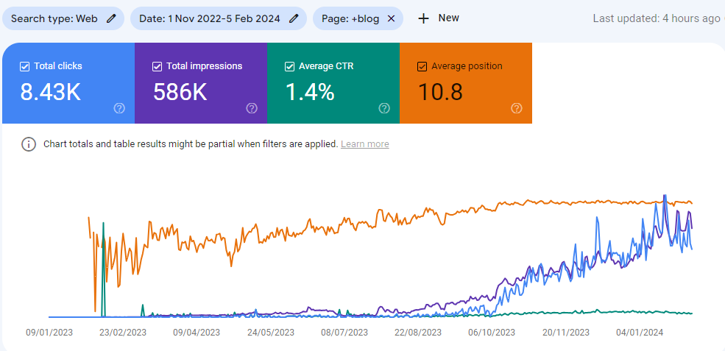
BLOGS PERFORMANCE ON SERP
Data taken from Google Search Console.

Slide 18
Blog Performance on SERP
All keywords on SERP for blog pages, their impression, clicks, CTR, and Average Position.
Top queries | Clicks | Impressions | CTR | Position
does popcorn expire | 245 | 18955 | 1.29% | 1.72
how long does popcorn last | 245 | 5018 | 4.88% | 1.62
how long is popcorn good for | 199 | 2576 | 7.73% | 1.20
does microwave popcorn go bad | 193 | 4911 | 3.93% | 2.28
expired popcorn | 129 | 3039 | 4.24% | 1.94
can you eat expired popcorn | 80 | 4568 | 1.75% | 2.98
does popcorn go bad | 73 | 4922 | 1.48% | 1.36
how long does microwave popcorn last | 65 | 1021 | 6.37% | 2.54
can popcorn expire | 61 | 6106 | 1.00% | 2.45
popcorn expiration date | 59 | 1086 | 5.43% | 1.96
how long is microwave popcorn good for | 57 | 1023 | 5.57% | 1.81
do popcorn kernels go bad | 51 | 7776 | 0.66% | 5.52
popcorn for breakfast | 51 | 1613 | 3.16% | 4.14
how long can popcorn last | 44 | 814 | 5.41% | 1.72
does microwave popcorn expire | 43 | 2090 | 2.06% | 3.10
View All

Slide 19

BACKLINKS REPORT
The total number of referring domains that have at least one link pointing to an analyzed domain/URL.
The number of unique visits to a root domain for the last month.
The total number of domains the analyzed domain or URL points to.
The total number of backlinks leading to an analyzed domain/URL.
An estimate of organic traffic driven to a root domain from Google search results.

Slide 20
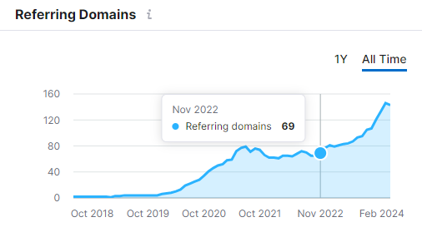
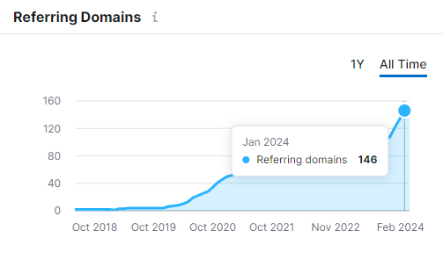
Referring Domains
Changes in the number of referring domains linking to an analyzed domain.
Referring Domains in Nov 22: 69
Referring Domains in Jan 24: 146

Slide 21
Referring Domains
Changes in the number of referring domains linking to an analyzed domain.
Referring Domains in Nov 22: 69
Referring Domains in Jan 24: 146

Slide 22
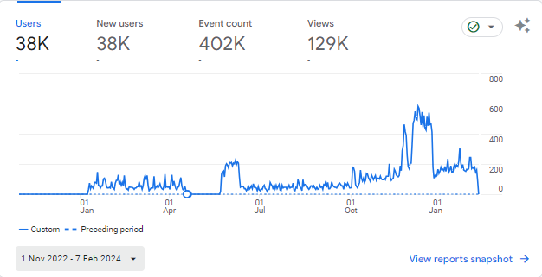
GOOGLE ANALYTICS: Overview​
This graph represents overview report for Nov 2022 to Feb 2024 which shows continuous growth.

Slide 23
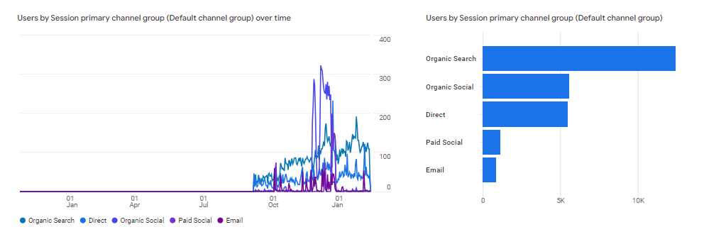
GOOGLE ANALYTICS: Traffic Acquisition
The above graph shows us traffic acquisition from Nov 2022 to Feb 2024.

Slide 24
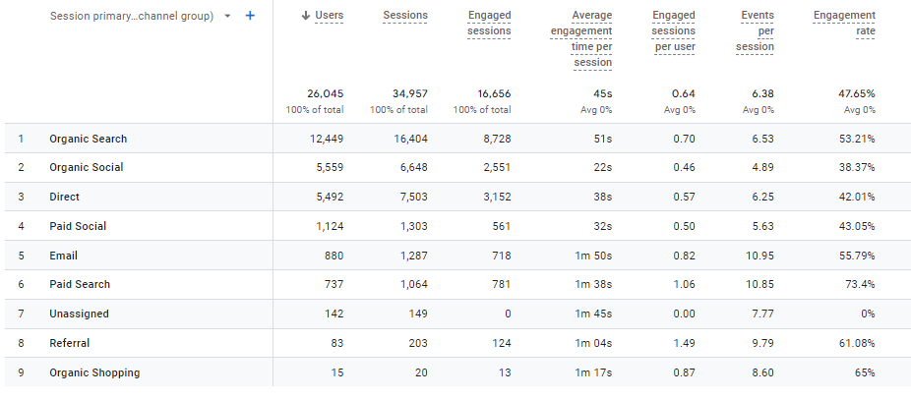
GOOGLE ANALYTICS: Traffic Acquisition
Detailed representation of traffic acquisition from various sources.

Slide 25
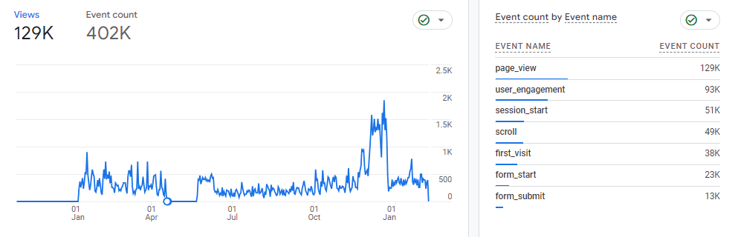
GOOGLE ANALYTICS: Engagement Overview
The above graph shows us data for engagement overview during the duration of Jun 23 – Jan 24.

Slide 26
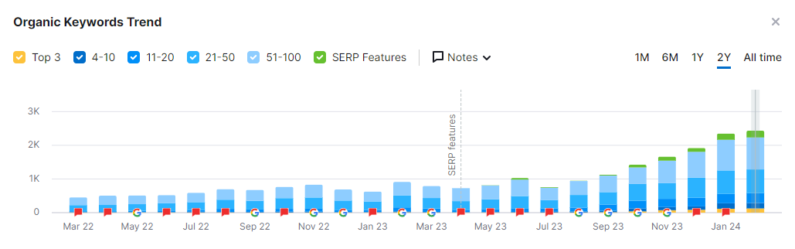
ORGANIC KEYWORDS GRAPH​
This Slide shows the Continuous growth on the website in the past Months. The Data is backed by the most trusted tool SEMrush. ​
2 Year Data Graph:​

Slide 27
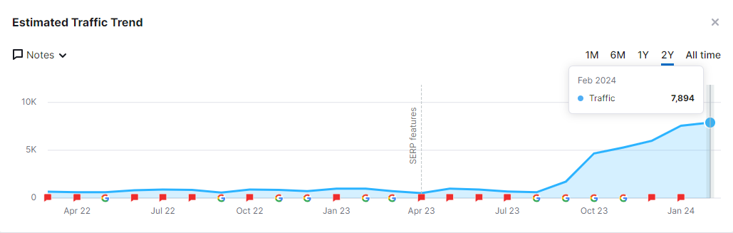
ORGANIC TRAFFIC GRAPH​
This Slide shows the Continuous growth on the website in the past Months. The Data is backed by the most trusted tool SEMrush. ​
2 Year Data Graph:​

Slide 28
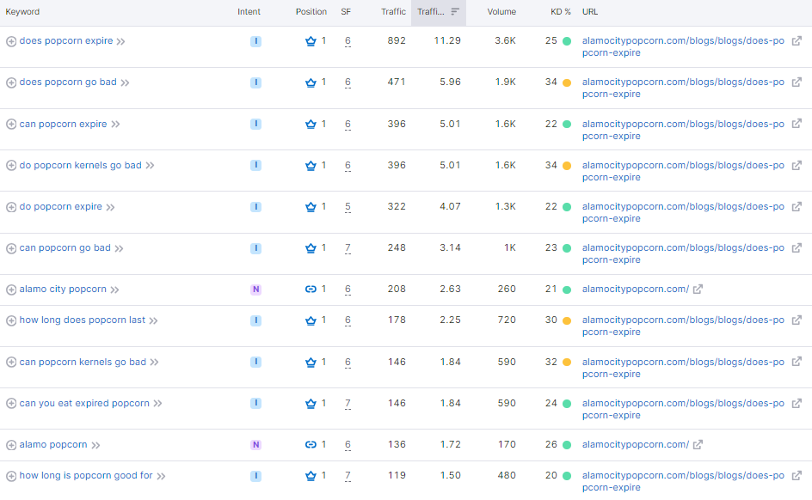
This Slide shows the keywords rank in the past Months. The Data is backed by the most trusted tool SEMrush. ​

Slide 29
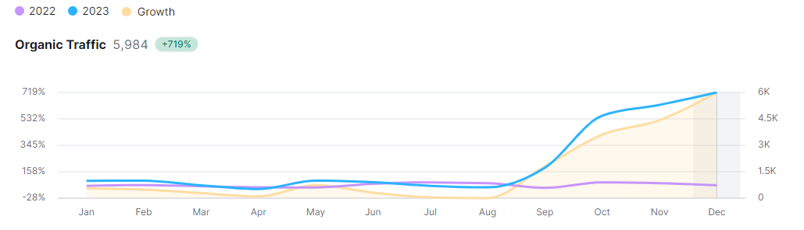
ORGANIC KEYWORD COMPARISON – 2022 to 2023​
This Slide shows the Growth Report Comparison for organic keywords drawn between 2022 and 2023, which shows +719% growth. ​

Slide 30
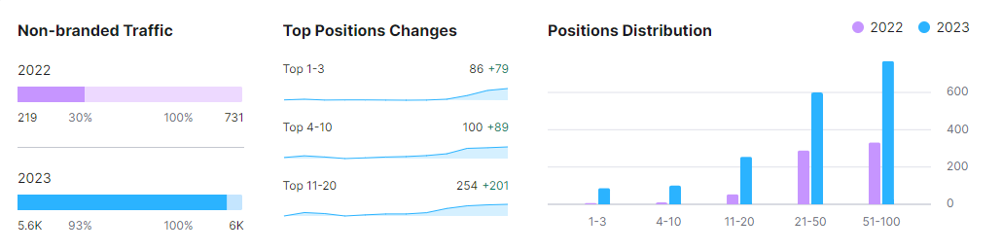
MISCELENIOUS GROWTH​
This Slide shows Non-branded Traffic, Top Position Changes and Position Distribution Compared between 2022 and 2023

Slide 31
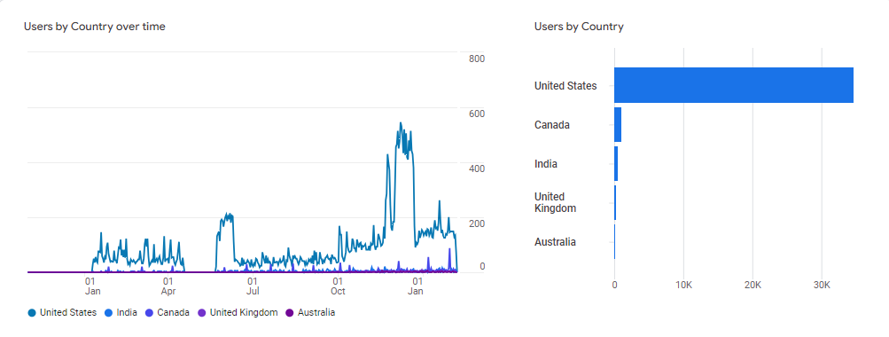
TRAFFIC BY COUNTRY​
This Slide shows Traffic Growth by Country in previous months that is Nov 2022 – Feb 2024.​

Slide 32
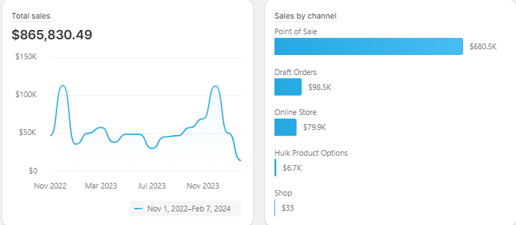
TOTAL SALES​
The below graph represents data for Total sales and Sales by channel on the website, for the duration of Nov 2022 to Feb 2024. ​

Slide 33
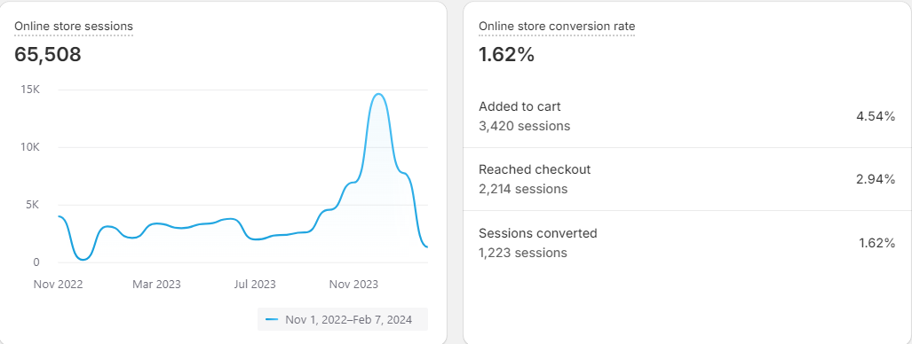
ONLINE STORE SESSIONS & CONVERSION RATE​
The above graph represents data for various channels through which the sales has been generated on the website, for the duration of June 2023 to Jan 2024. ​

Slide 34
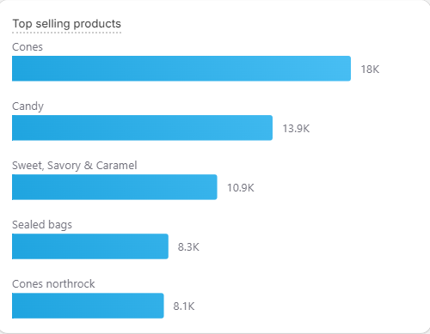

TOP SELLING PRODUCTS​
Products with the most individual units sold. Includes orders from all sales channels.​

Slide 35
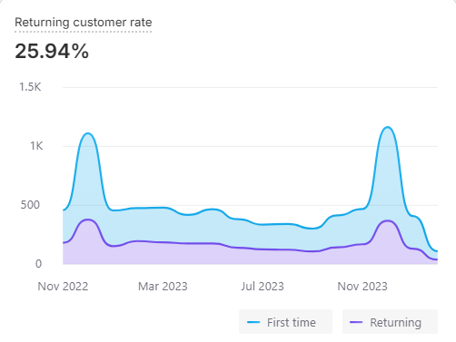
RETURNING CUSTOMER RATE​
This graph shows the data for Nov 2022 – Feb 2024, Returning customer rate on the website.​

Slide 36
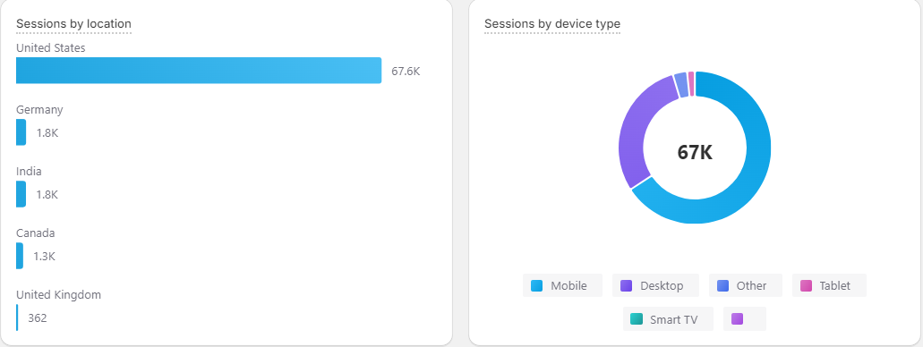
SESSIONS BY LOCATION & DEVICE TYPE​
This graph represents the data for sessions by location and sessions by device type on the website, for the duration of Nov 2022 – Feb 2024.​

Slide 37
RESEARCH, ANALYSIS​
& SUGGESTIONS
Backlink Building​ & Website Blogs:
  Implement a backlink-building strategy to acquire high-quality backlinks from authoritative websites in the same industry by increasing the count of backlinks.​
  Focus on publishing more website blogs to generate informative content and attract more users.​
Google Ads:
  Start with the P-Max Ad campaign to reach & target audience on various other platforms like Shopping Tab other Google Apps.

Slide 38
SUGGESTIONS
Competitor & Market Analysis:
Integrate Google Maps and reviews on the website.
Need to add Popcorn cones, build your own, and sealed popcorn bags in the navigation.
Need to make the collection description live.
Need to add policy pages: Privacy Policy, Return & Refund Policy, and Shipping Policy.
Add some offer such as Free Shipping on orders $_+ in the header
Valentine’s Banner too big- need to reduce the banner size.
Need to add USPs on Homepage.
Ex- Proudly Made in the USA, Non-GMO & Dairy Free, Handcrafted in Small Batches, 100% Satisfaction Guaranteed (this will help build trust)
Need to add more content on About us page.

Slide 39
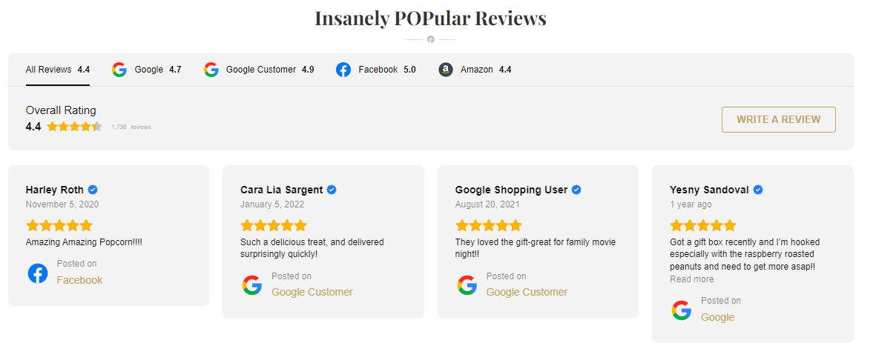
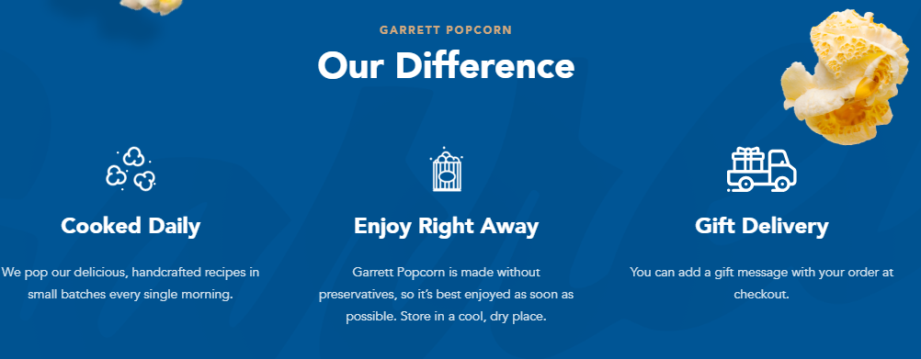
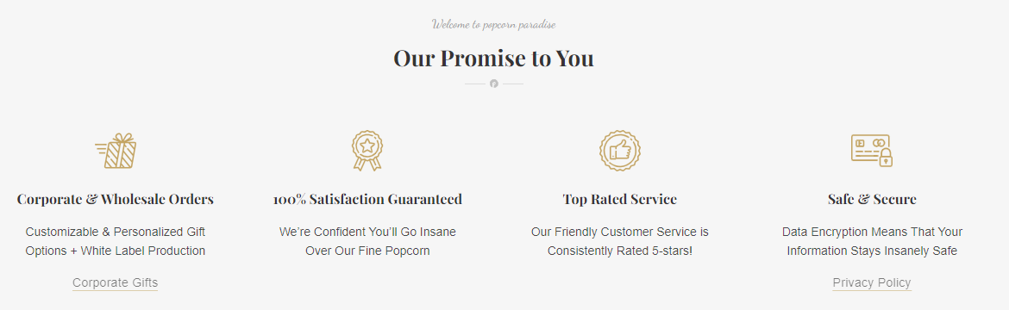

SUGGESTIONS EXAMPLES:

Slide 40



THANK
YOU

